Slide 1
Amazon Sales

Slide 2
Agenda
ETL: Extract-Transform-Load some Amazon dataset
find for me Sales-trend -> month-wise, year-wise, yearly month-wise
Find key metrics and factors and show the meaningful relationships between attributes.

Slide 3
Strategies for Growth
Navigating the future

Slide 4
Regional Performance
Sub-Saharan Africa appears to have a strong market for Office Supplies, with several high-revenue transactions in this category from countries like Senegal, Rwanda, and Sierra Leone.
Asia dominates in the Cosmetics category, with Sri Lanka having the highest revenue transaction ($3,039,414.40) among all regions.
Central America and the Caribbean, as well as North America (represented by Mexico), seem to have a significant demand for Household items, with Honduras and Mexico having the highest revenue transactions in this category for their respective regions.

Slide 5
Product Category Trends
Baby Food is a prominent category in Australia and Oceania, with high-revenue transactions from countries like Tuvalu, New Zealand, and Australia.
Cereal is a popular category in Sub-Saharan Africa, with countries like Senegal and Cameroon contributing to high-revenue sales.
Fruits and Vegetables appear to be commonly purchased online in Sub-Saharan African countries like Sao Tome and Principe, Mali, and Cameroon.

Slide 6
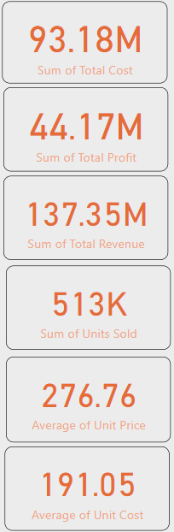
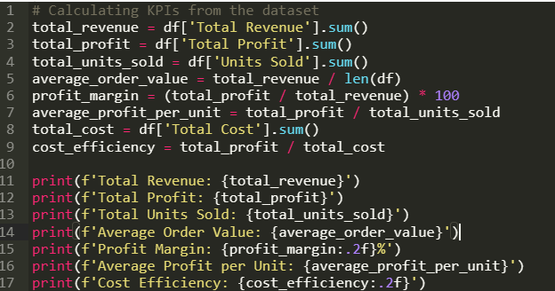
Key Performance Indicators (KPIs)
Total Revenue: $137,348,768.31
Total Profit: $44,168,198.40
Total Units Sold: 512,871 units
Average Order Value: $1,373,487.68 per order
Profit Margin: 32.16%
Average Profit per Unit: $86.12 per unit
Cost Efficiency: 0.47

Slide 7
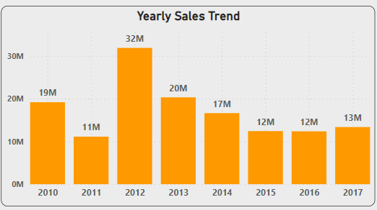
Yearly Sales Trend
The total revenue shows fluctuations over the years with a peak in 2012. This could indicate a successful product launch or a strong market condition in that year.
There's a noticeable decline in total revenue from 2012 onwards, stabilizing somewhat after 2016. This trend might suggest changes in market dynamics, increased competition, or changes in consumer preferences.

Slide 8
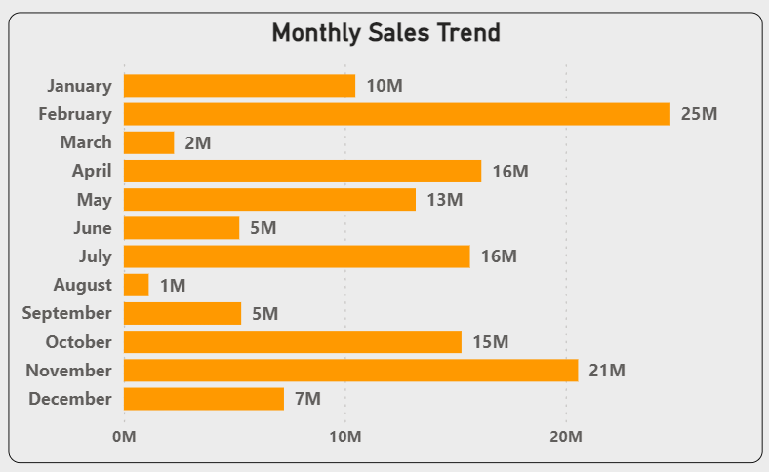
Monthly Sales Trend
February and November show significantly higher sales compared to other months, which might be influenced by seasonal sales events like Valentine's Day and Black Friday.
The lowest sales occur in March and August, which could be off-peak seasons for this particular market.

Slide 9
Yearly-Monthly Sales Trend
The breakdown of monthly sales within each year shows that certain months consistently perform well or poorly across different years. This pattern can help in planning marketing strategies and inventory management.
The data from 2010 and 2011 shows a concentration of higher sales in the later months of the year, suggesting a strong end-of-year sales performance possibly due to holiday shopping.

Slide 10
Conclusion
These insights can help in understanding the sales cycle better, identifying potential areas for growth, and strategizing for future sales and marketing efforts.

Slide 11
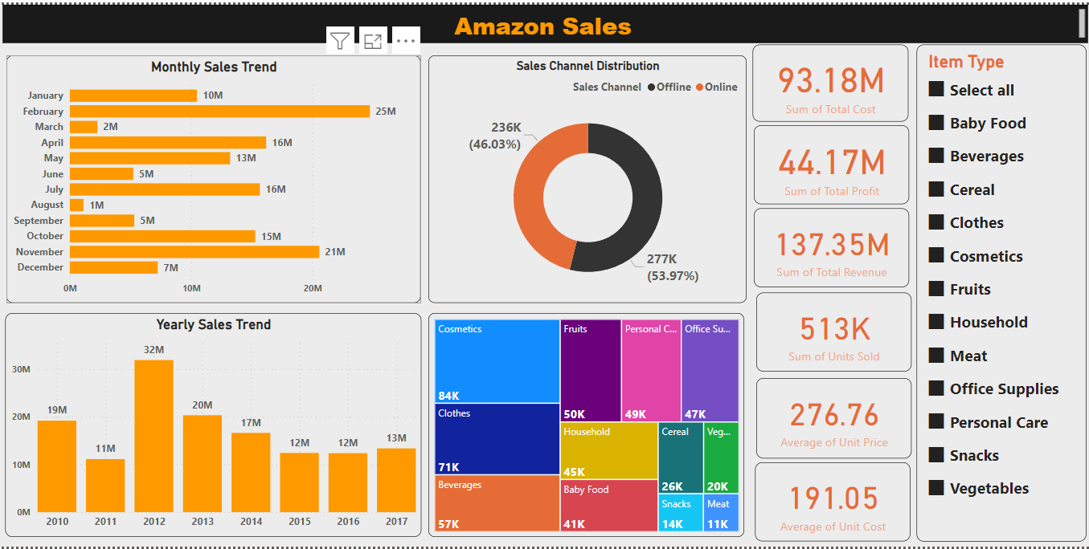
Dashboard

Slide 12
Thank you
Gopi Chand Mulaveesala | gopimulaveesala81@gmail.com |Portfolio : https://gopimulaveesala.github.io/gopi/

